Slide 1
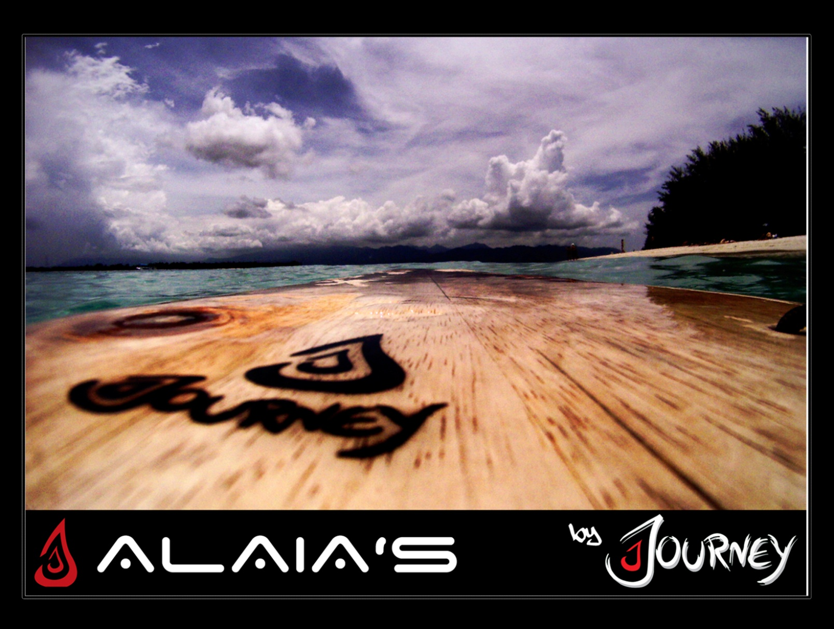

Slide 2
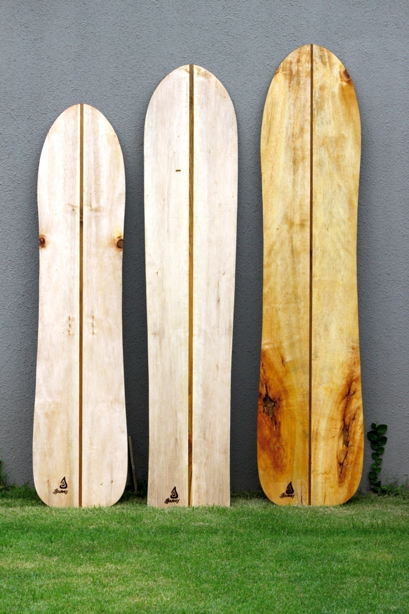
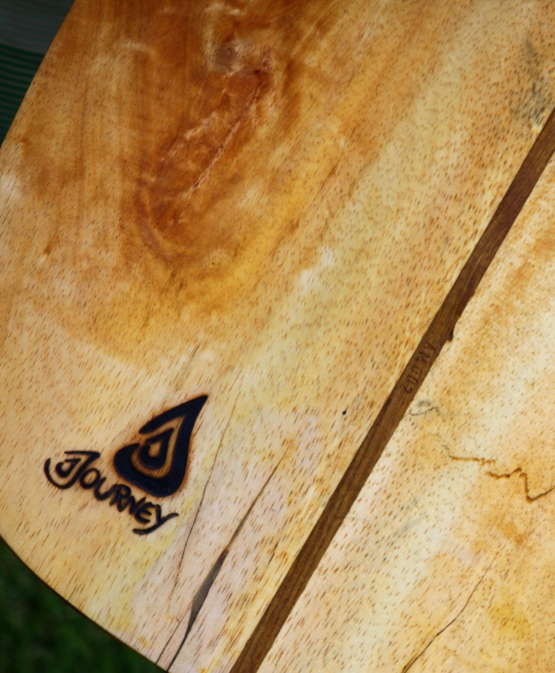

Slide 3
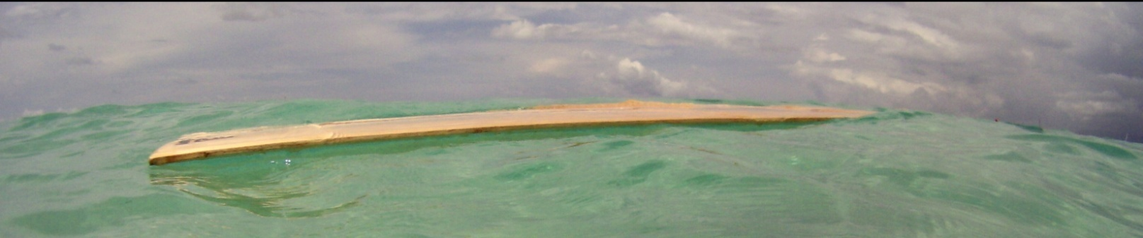
Alaias by Journey
Journey Alaias are boards of art and performance. Handcrafted in Bali in cooperation with independent traditional wood working families, making each of the boards unique.
Hand selected, environmentally resourced wood is used in each model, along with natural oils and waxes. This ensures a long life for each of the boards.
Special shapes and foils enable easy handling of our Alaias.
Each of our boards has a specialised serial number which can be used to identify the date of production, and the shaper who crafted the board.
Before buying an alaia its important to know which model will suit you and your ability. Learning to ride an alaia is difficult, so its recommended to have the basics of standard surfing before starting alaia riding. It is always recommended to start with the Pleasure Alaia. These boards are designed for first time riders as they have more buoyancy, a leash and are easier to trim than a standard alaia.
www.journey-styles.com

Slide 4
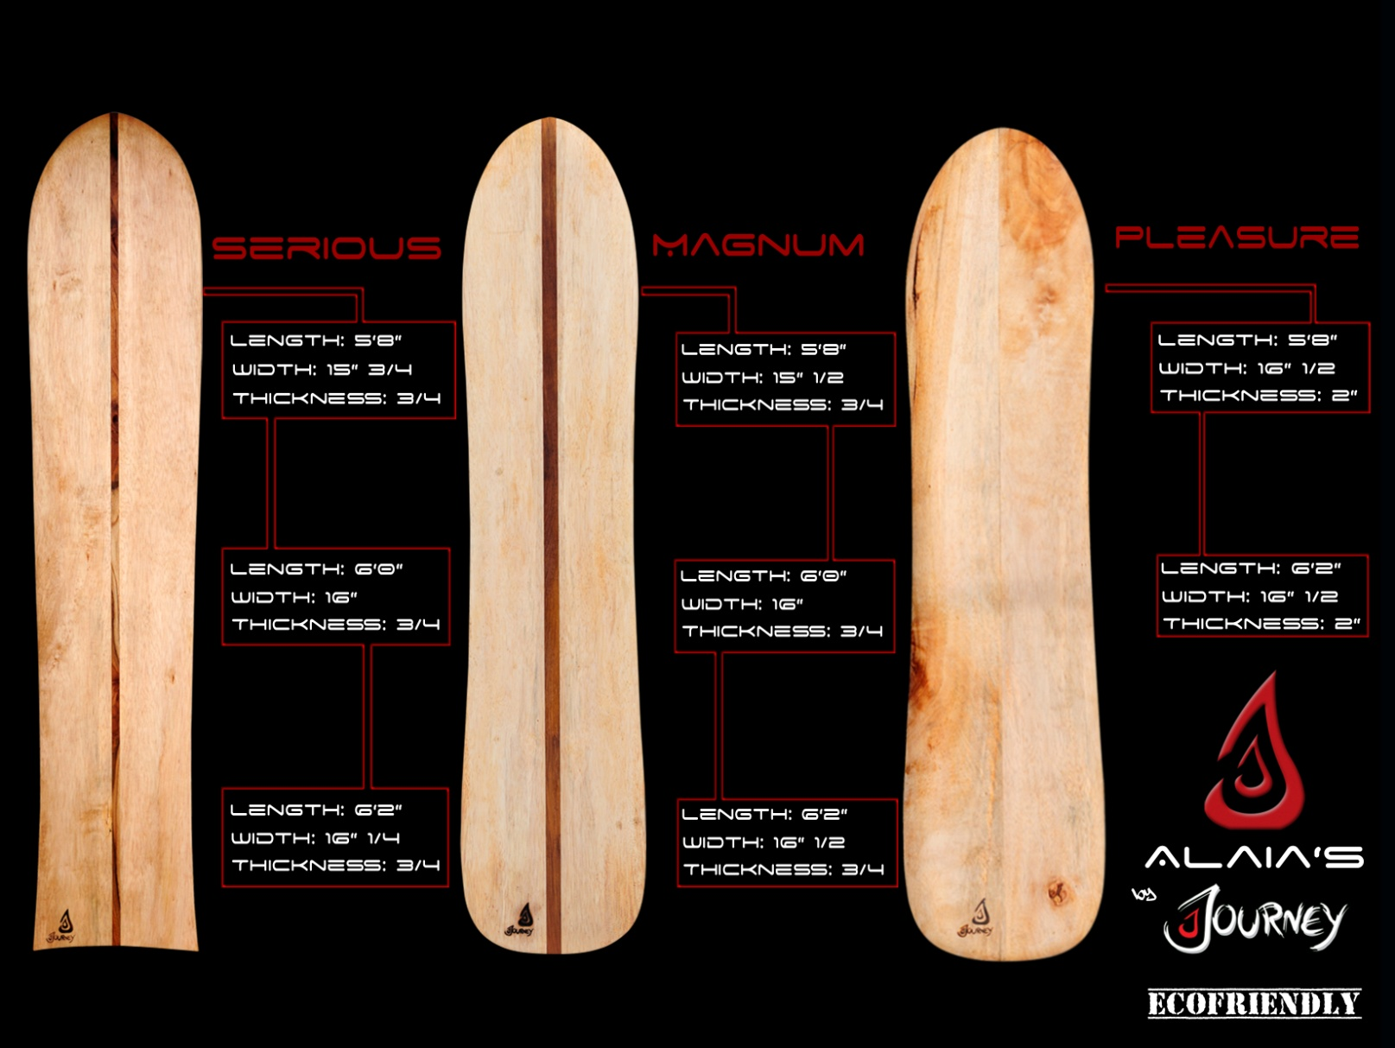

Slide 5
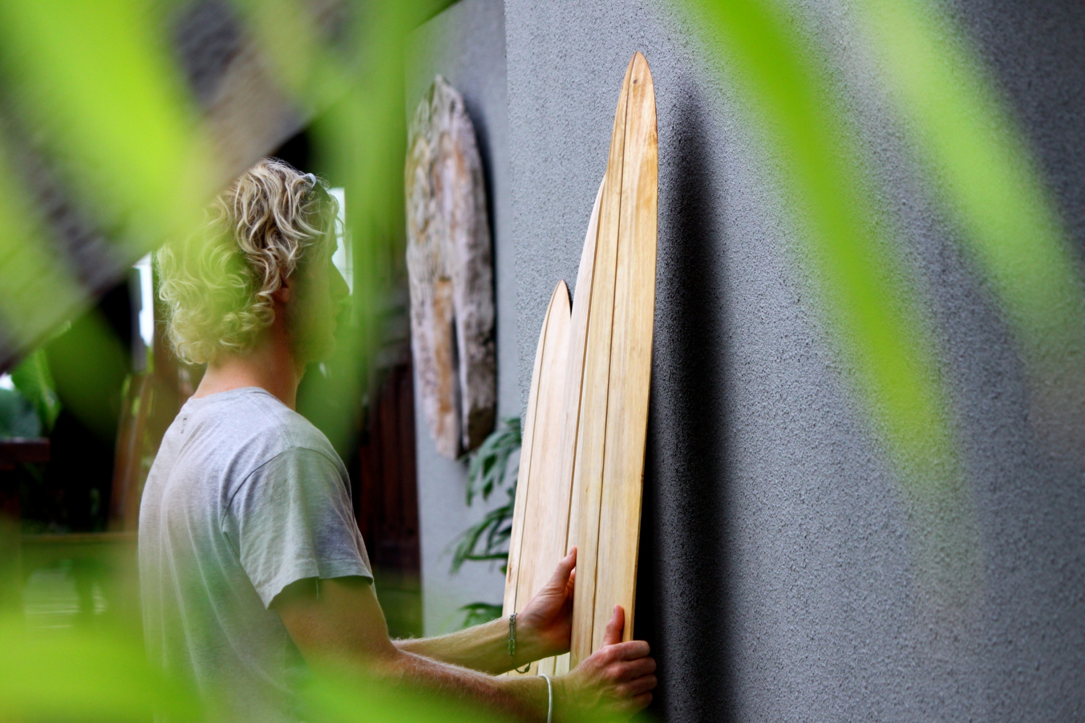

Slide 6
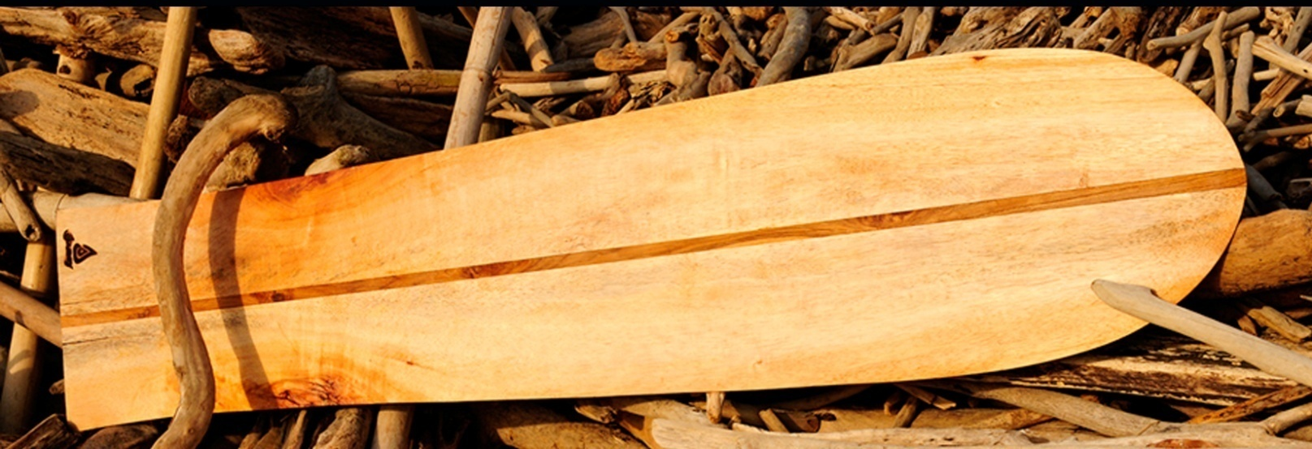
Wood Used in our Boards:
Albalsia
Albalsia is an economical friendly lightweight yellow wood planted readily by farmers in Indonesia. It is easy to farm and its fast growing properties give it a good commercial value. Harvested after four years, the wood is then worked and treated with 100% ecofriendly oils, waxes and resins. Harvested from certified sources.
Teak
Teak belongs to the family of Lamiaceae. It’s a yellowish, brown wood with a beautiful grain and is used as the stringer in our boards. The teak is sustainably grown and harvested on plantations in Indonesia. Treated with 100% ecofriendly oils, waxes and resins. Harvested from certified sources.

Slide 7
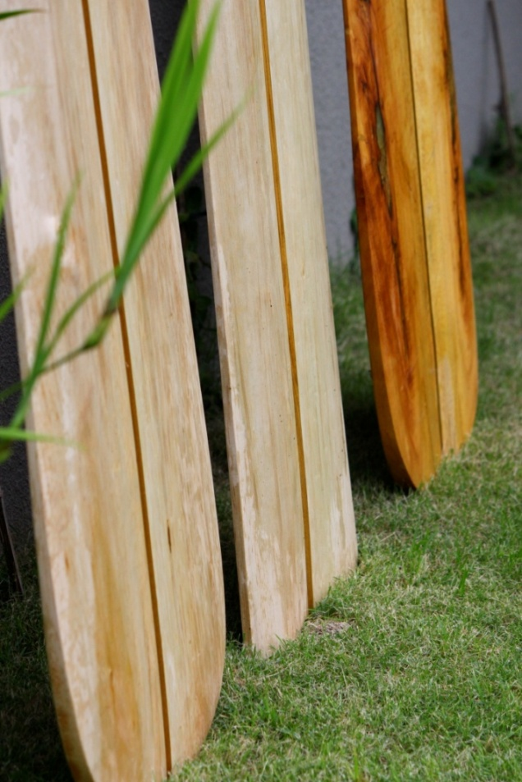
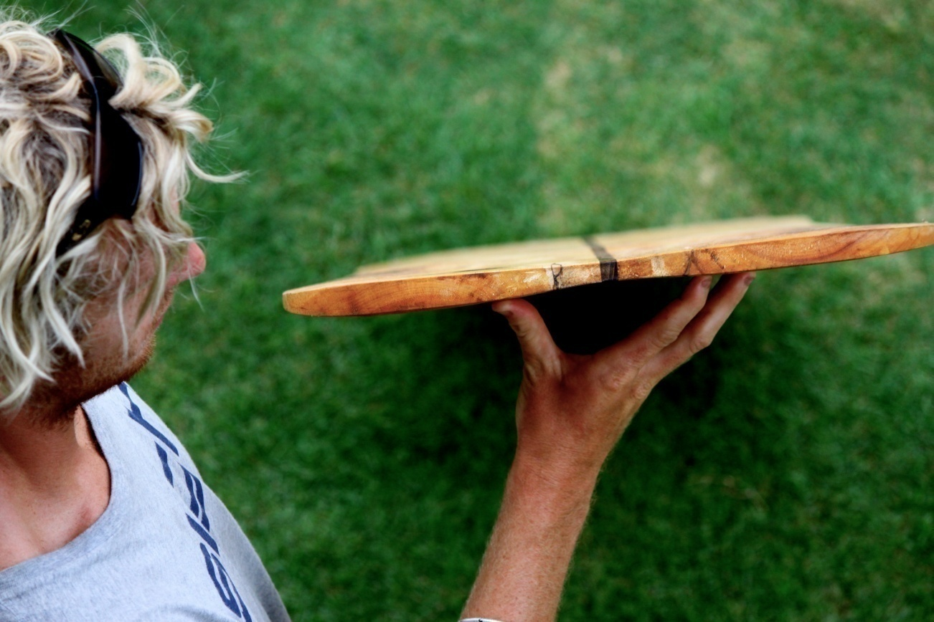
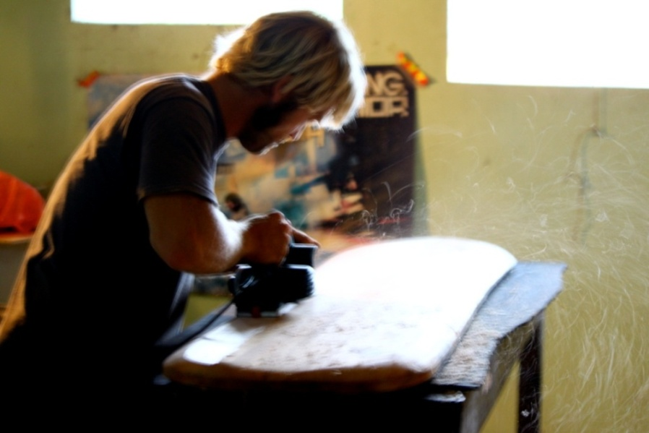
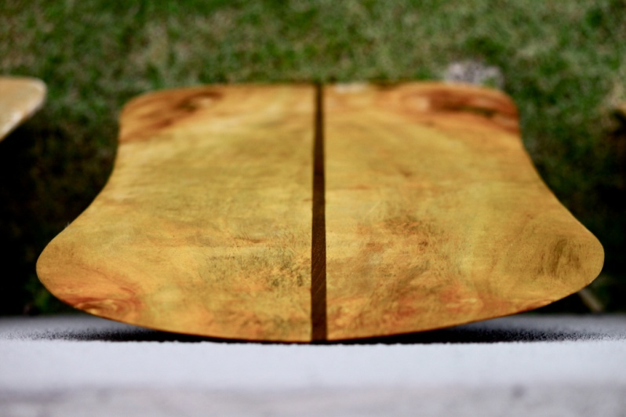


Slide 8
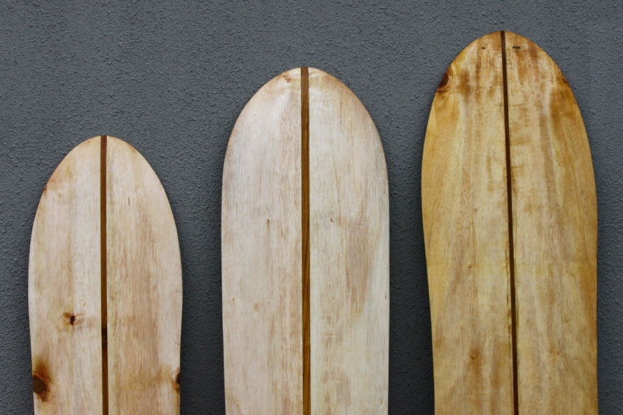
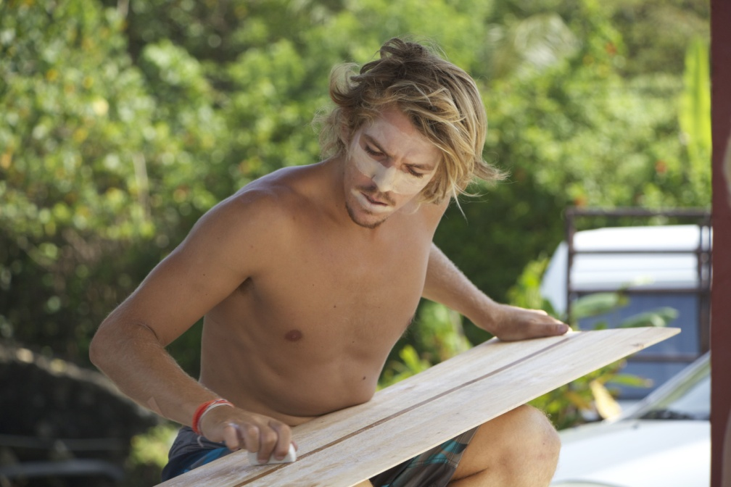

JOURNEY combines the unique and specialized wood crafting skills of local craftsmen with state of the art research and design in hydrodynamics, to reach the goal of high performance.
This combination creates beautiful, hand crafted board riding equipment. As well as the stunning aesthetics, the equipment is built for high performance surfing.
These factors give the Wooden Movement the performance it needs for the 21st century.
JOIN THE JOURNEY
www.journey-styles.com

